Slide 1
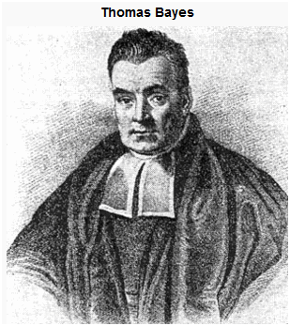
Bayes for Beginners
Anne-Catherine Huys M. Berk Mirza
Methods for Dummies
20th January 2016

Slide 2
Of doctors and patients
A disease occurs in 0.5% of population
A diagnostic test gives a positive result in:
99% of people with the disease
5% of people without the disease (false positive)
A random person off the street is found to have a positive test result.
What is the probability of this person having the disease?
A: 0-30%
B: 30-70%
C: 70-99%

Slide 3

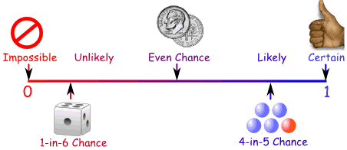

Probabilities for dummies
Probability 0 – 1

Slide 4
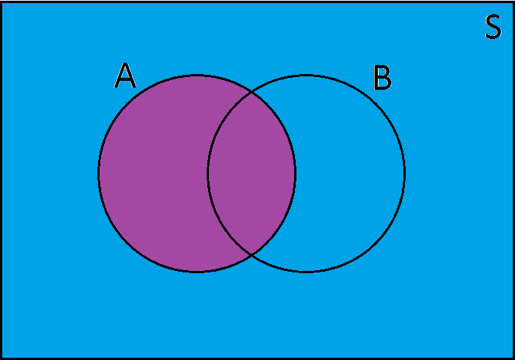
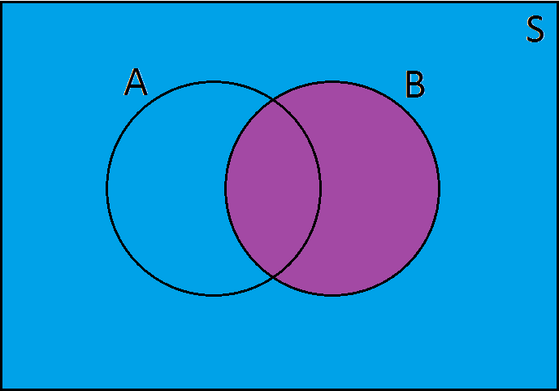
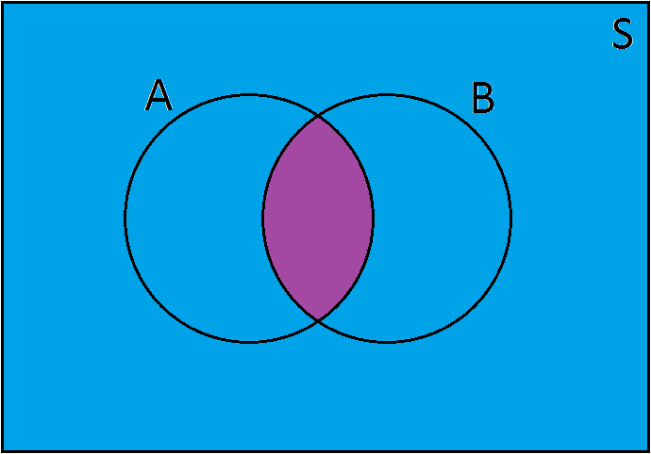
Probabilities for dummies
P(A) = probability of the event A occurring
P(B) = probability of the event B occurring
Joint probability (intersection)
Probability of event A and event B occurring
P(A,B)
P(A∩B)
Order irrelevant
P(A,B) = P(B,A)

Slide 5
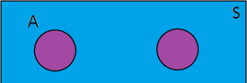
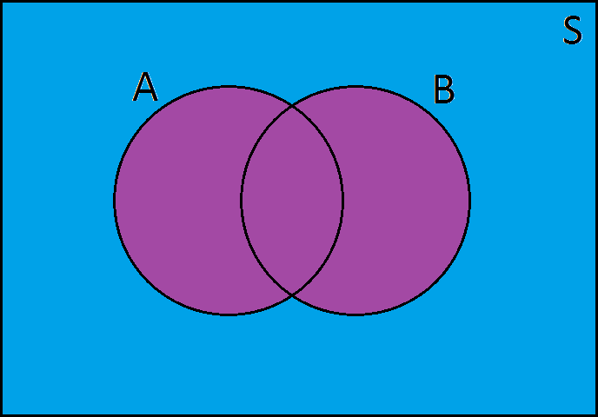
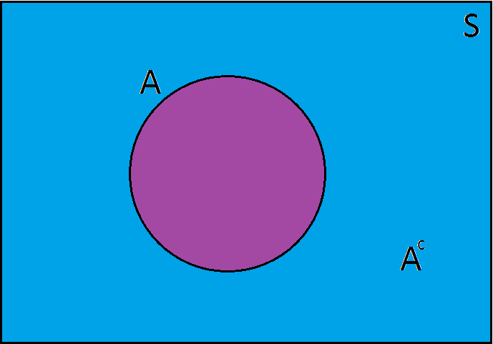
Probabilities for dummies
Union
Probability of event A or event B occurring
P(A∪B) = P(A) + P(B)
P(A∪B) = P(A)+P(B) – P(A∩B)
Order irrelevant
P(A∪B) = P(B∪A)
Complement - Probability of anything other than A
(P~A) = 1-P(A)
A
B

Slide 6




20
4
6
2
8
 |  | colour
 |  | Red | green
shape | Cube | 0.2 | 0.3
 | Sphere | 0.1 | 0.4
Marginal probability (sum rule)
Probability of a sphere (regardless of colour)
P(sphere) = ∑ P(sphere , colour)
^{colour}
P(A) = ∑ P(A , B)
^{B}
Conditional probability
A red object is drawn, what is the probability of it being a sphere?
The probability of an event A, given the occurrence of an event B
P(A|B) ("probability of A given B")
0.5
0.333

Slide 7
From conditional probability to Bayes rule

Slide 8
Bayes’ Theorem
θ = the population parameter
data = the data of our sample
Likelihood
Prior
P(data|θ) x
P(θ)
Posterior
P(θ|data)
=
P(data)
Marginal
Invert the question (i.e. how good is our hypothesis given the data?)
prior knowledge is incorporated and used to update our beliefs

Slide 9
Back to doctors and patients
A disease occurs in 0.5% of population.
99% of people with the disease have a positive test result. 5% of people without the disease have a positive test result.
→ random person with a positive test → probability of disease??

Slide 10
P(positive test)
A disease occurs in 0.5% of population.
99% of people with the disease have a positive test result. 5% of people without the disease have a positive test result.
→ random person with a positive test → probability of disease??
Marginal probability
Conditional probability
P(A,B) = P(A|B) * P(B)
P(positive test, disease state) =(positive test|disease state) *P(disease)
P(A) = ∑ P(A , B)
^{B}
P(positive test) = ∑ P(positive test , disease states)
^{disease} ^{states}
= 0.99 * 0.005
+ 0.05 * 0.995 = 0.055

Slide 11
Back to doctors and patients
A disease occurs in 0.5% of population.
99% of people with the disease have a positive test result. 5% of people without the disease have a positive test result.
→ random person with a positive test → probability of disease??

Slide 12
Example:
Someone flips coin.
We don’t know if the coin is fair or not.
We are told only the outcome of the coin flipping.

Slide 13
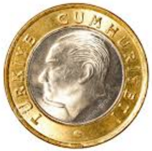

Example:
1st Hypothesis: Coin is fair, 50% Heads or Tails
2nd Hypothesis: Both side of the coin is heads, 100% Heads

Slide 14
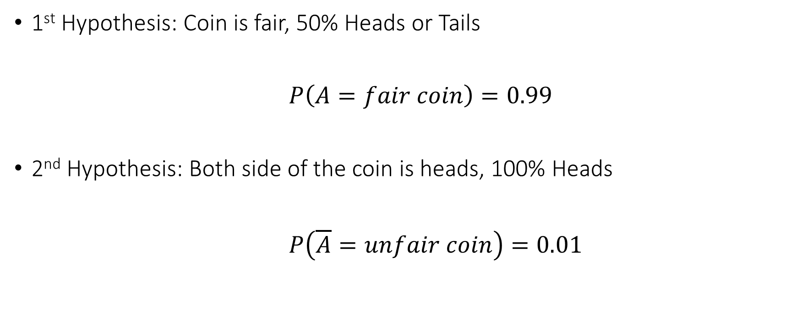
Example:
1st Hypothesis: Coin is fair, 50% Heads or Tails
$$P\left(A=fair coin\right)=0.99$$
2nd Hypothesis: Both side of the coin is heads, 100% Heads
$$P\left(\overline{A}=unfair coin\right)=0.01$$

Slide 15
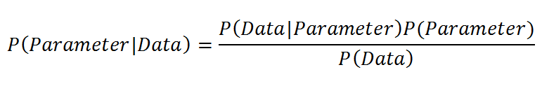
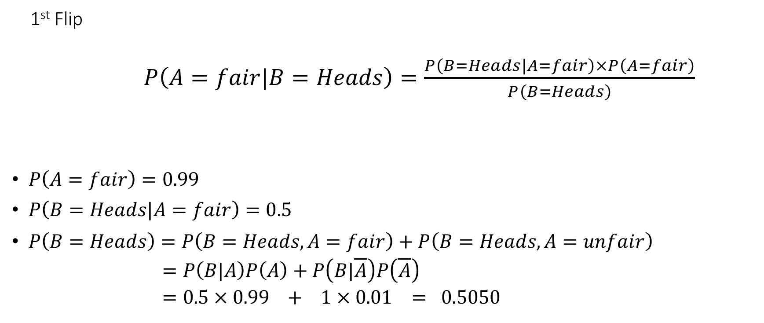
Example:
1st Flip
$P\left(A=fair|B=Heads\right)=\frac{P\left(B=Heads|A=fair\right)×P\left(A=fair\right)}{P\left(B=Heads\right)}$
$P\left(A=fair\right)=0.99$
$P\left(B=Heads|A=fair\right)=0.5$
$P\left(B=Heads\right)=P\left(B=Heads,A=fair\right)+P\left(B=Heads,A=unfair\right)$
$=P\left(B|A\right)P\left(A\right)+P\left(B|\overline{A}\right)P\left(\overline{A}\right)$
$=0.5×0.99 + 1×0.01 = 0.5050$

Slide 16
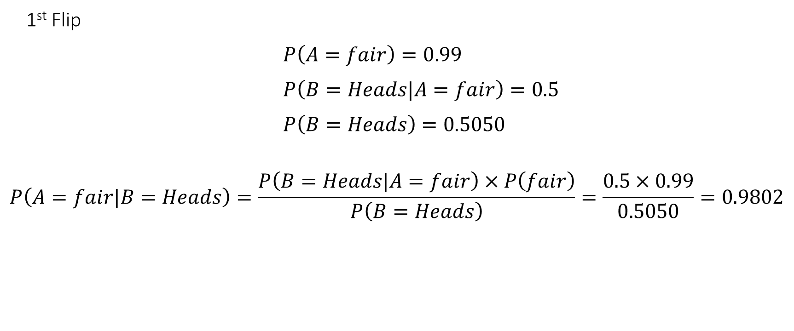
Example:
1st Flip
$P\left(A=fair\right)=0.99$
$P\left(B=Heads|A=fair\right)=0.5$
$P\left(B=Heads\right)=0.5050$
$$P\left(A=fair|B=Heads\right)=\frac{P\left(B=Heads|A=fair\right)×P\left(fair\right)}{P\left(B=Heads\right)}=\frac{0.5×0.99}{0.5050}=0.9802$$

Slide 17
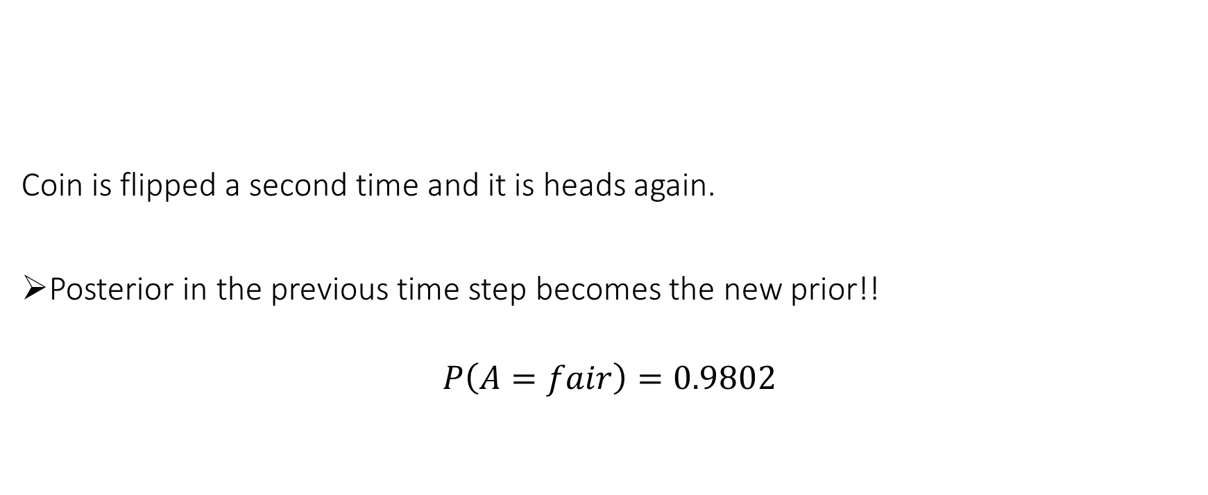
Example:
1st Flip 2nd Flip
Coin is flipped a second time and it is heads again.
Posterior in the previous time step becomes the new prior!!
$$P\left(A=fair\right)=0.9802$$

Slide 18
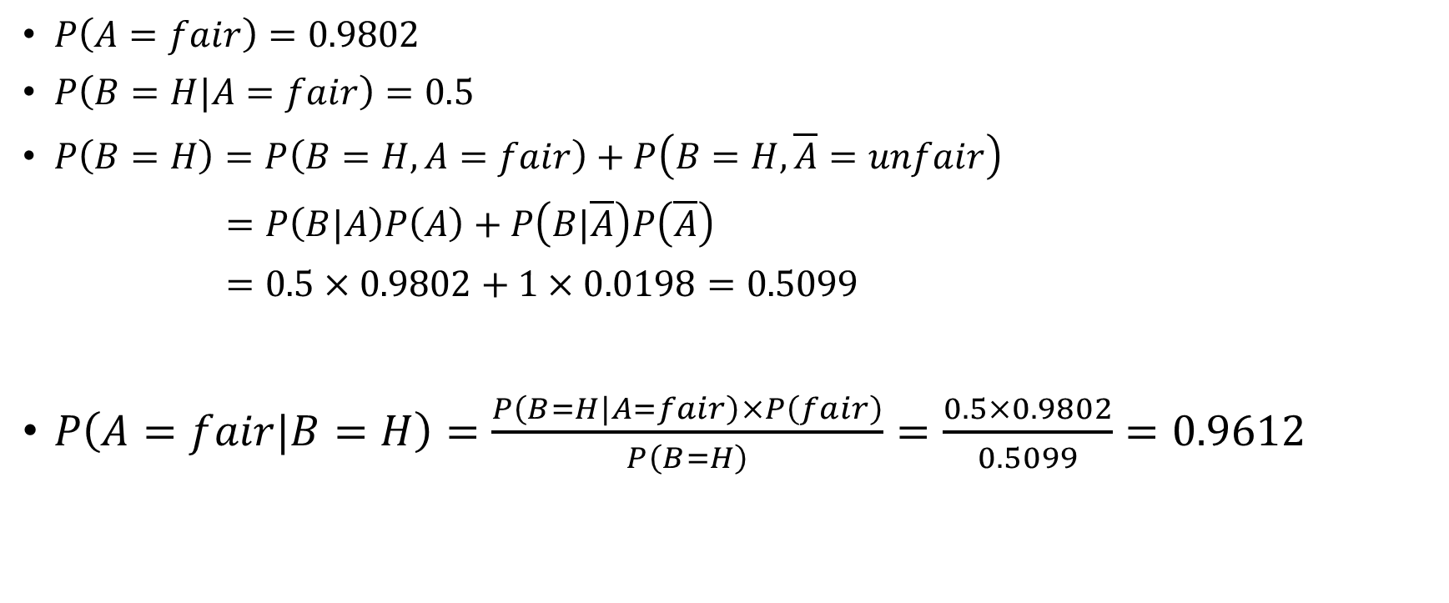
Example:
$P\left(A=fair\right)=0.9802$
$P\left(B=H|A=fair\right)=0.5$
$P\left(B=H\right)=P\left(B=H,A=fair\right)+P\left(B=H,\overline{A}=unfair\right)$
$=P\left(B|A\right)P\left(A\right)+P\left(B|\overline{A}\right)P\left(\overline{A}\right)$
$=0.5×0.9802+1×0.0198=0.5099$
$P\left(A=fair|B=H\right)=\frac{P\left(B=H|A=fair\right)×P\left(fair\right)}{P\left(B=H\right)}=\frac{0. 5×0.9802}{0.5099}=0.9612$

Slide 19
Example:

Slide 20
Example

Slide 21
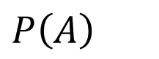
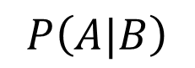
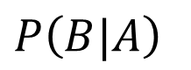
Prior, Likelihood and Posterior
Prior:
Likelihood:
Posterior:
$$P\left(A\right)$$
$$P\left(B|A\right)$$
$$P\left(A|B\right)$$

Slide 22
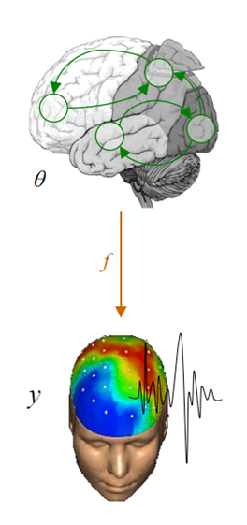
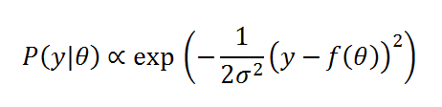
Bayesian Paradigm
- Model of the data:
y = f(θ) + ε e.g. GLM, DCM etc.
- Assume that noise is small
- Likelihood of the data given the parameters:
Noise

Slide 23
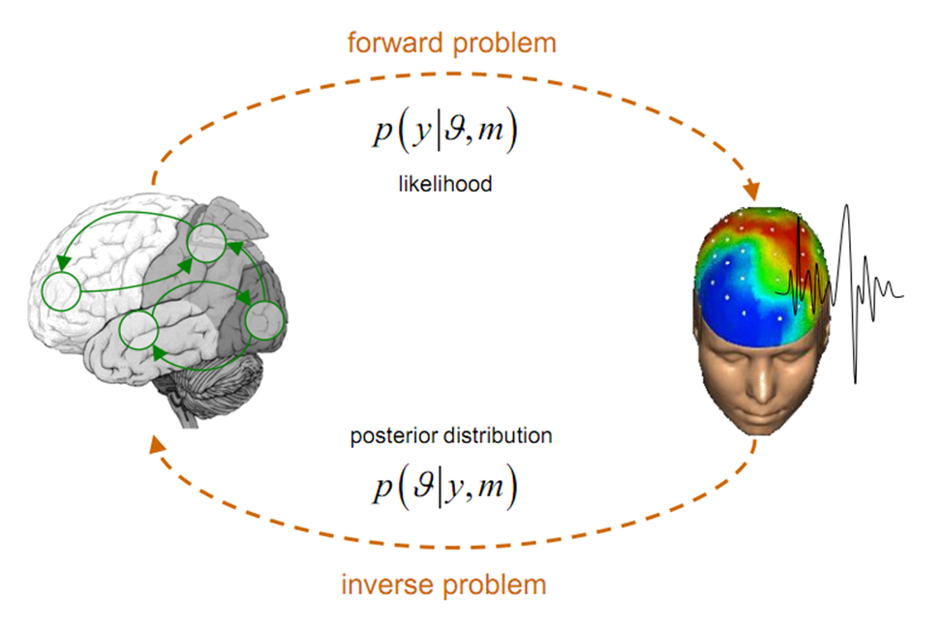
Forward and Inverse Problems
P(Data|Parameter)
P(Parameter|Data)

Slide 24
Complex vs Simple Model

Slide 25
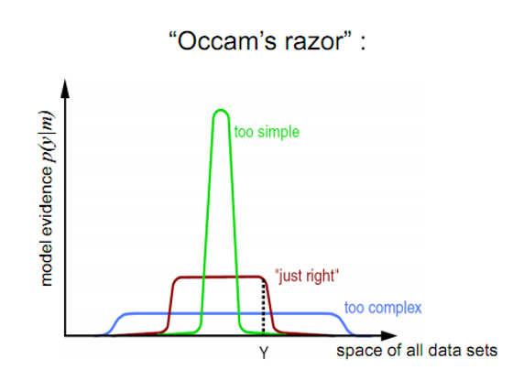
Principle of Parsimony

Slide 26
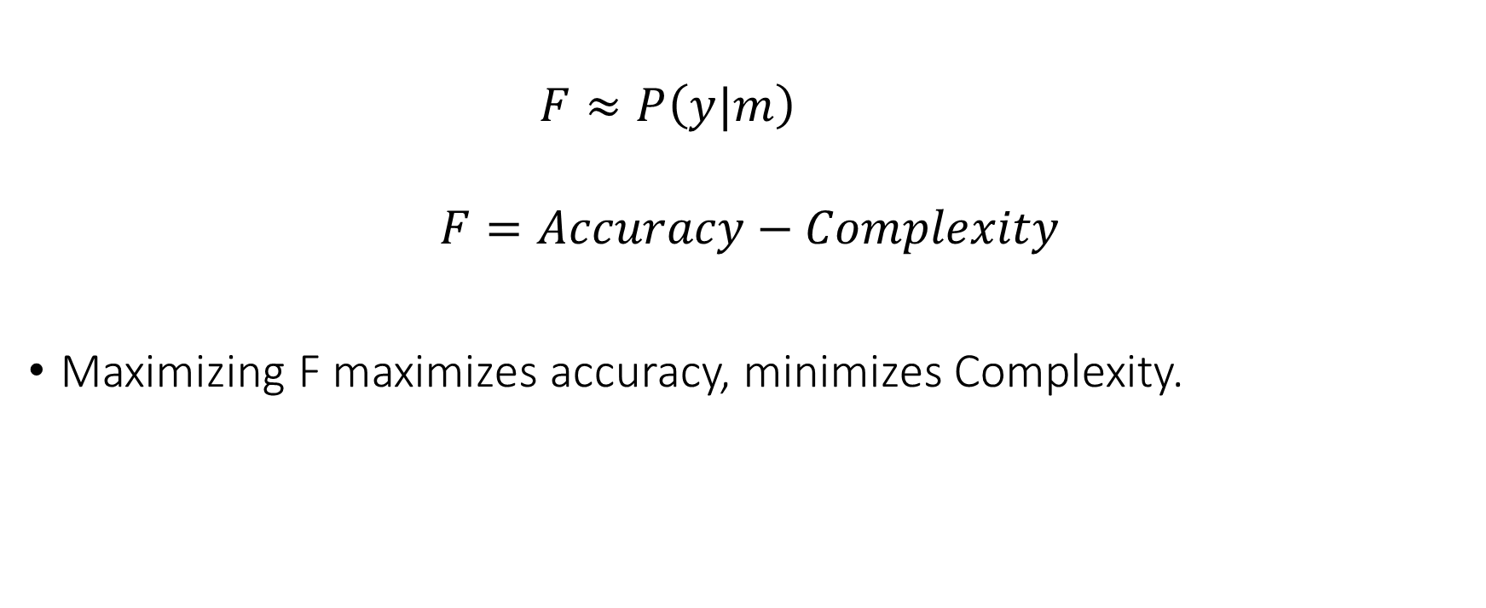
Free Energy
$$F≈P\left(y|m\right)$$
$$F=Accuracy−Complexity$$
Maximizing F maximizes accuracy, minimizes Complexity.

Slide 27
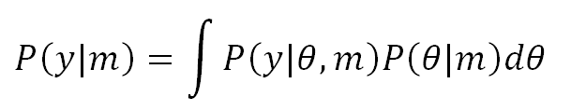
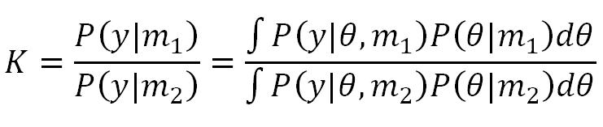
Bayesian Model Comparison
Marginal likelihood
Bayes Factor
$e.g. K>20$ strong evidence that model 1 is better

Slide 28
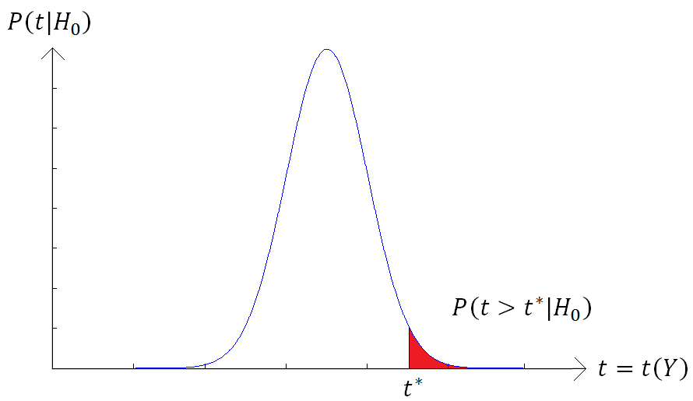
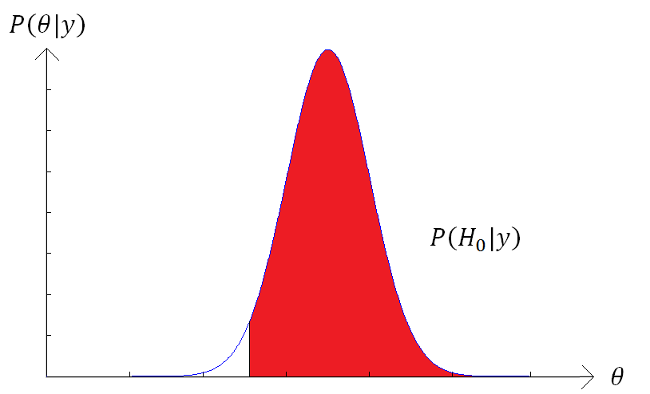
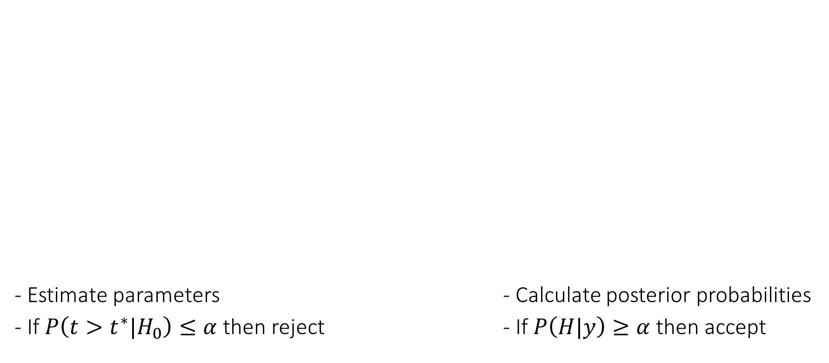
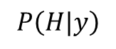
Hypothesis testing
Classical SPM
Define the null hypothesis
H0: Coin is fair θ=0.5
Bayesian Inference
Define a hypothesis
H: θ>0.1
- Estimate parameters - Calculate posterior probabilities
- If $P\left(t>t^{∗}|H_{0}\right)≤α$ then reject - If $P\left(H|y\right)≥α$ then accept
$$P\left(H|y\right)$$
0.1

Slide 29
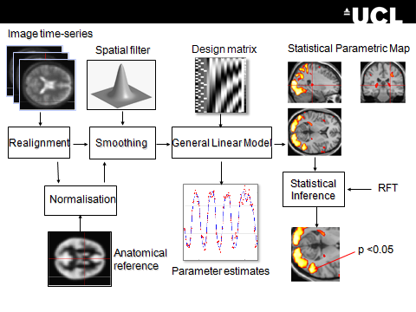
Dynamic Causal Modelling
Multivariate Decoding
Posterior Probability Maps
Bayesian Algorithms

Slide 30
References
Dr. Jean Daunizeau and his SPM course slides
Previous MfD slides
Bayesian statistics: a comprehensive course – Ox educ – great video tutorials https://www.youtube.com/watch?v=U1HbB0ATZ_A&index=1&list=PLFDbGp5YzjqXQ4oE4w9GVWdiokWB9gEpm

Slide 31
Special Thanks to
Dr. Peter Zeidman

